Slide 1

Green Pace
Security Policy Presentation
Developer: Jordan Hollis
In the digital world, cyber attacks can happen at any given moment. To sleep soundly at night, follow these given principles and coding standards to keep your data safe.

Slide 2

OVERVIEW: DEFENSE IN DEPTH
Defense in Depth is the most recommended method when it comes to keeping data locked away from cyber threats. This method involves using multiple independent security controls that are broken down into three categories which are technical, physical, and administrative controls. Administrative cover the policies, procedures and training. Physical controls cover the physical access to the infrastructure, and technical covers the configuration of both software and hardware that guard any digital system.

Slide 3
THREATS MATRIX
There are a total of four threat levels. These levels are going to determine how severe this threat is.
Likely A cyber-attack that will most likely occur. | Priority A cyber threat that needs to be dealt with.
Low priority A cyber threat that most likely won't occur. | Unlikely A cyber-attack that probably isn't going to happen.

Slide 4
10 PRINCIPLES
Validate your input data.
Heed to the compiler warnings.
Plan the architecture and set the security policies in place.
Keep things simple.
Always default deny.
Go by the principle of least privileged
Have the data properly sanitized before sending it off to another system.
Always practice the Defense in Depth method.
Employ effective quality assurance techniques.
Stick to the best secure coding standards.

Slide 5
CODING STANDARDS
Data Type: This standard sets the rules in place that all developers must abide by.
Data Value: This promises that data is being recorded, handled, and processed to prevent any security problems and reduce errors.
String Correctness: This deals with reducing bugs, patching up any security vulnerabilities, and boosting the code's performance.
SQL Injection: This deals with separating an SQL code that's executable from data that is user-supplied.
Memory guard: This standard sets the rules to eliminate any memory related bugs or buffer overflows.
Assertion: This is a boolean code that will confirm any bugs present when testing is occurring.
Exception: This standard will govern how programmers find, throw, and handle an application with runtime errors.
Assess: This standard deals with checking that the codebase is following the rules and formatting.
Values: The values define the rules and best coding practices that programmers use to write and structure source code.
If/else statements: These statements will make sure your codebase is secured and easy to maintain.

Slide 6
ENCRYPTION POLICIES
Encryption in flight: This is the process of encrypting data while the data is being sent away. It uses mathematical ciphers to scramble up the data to make it unreadable and it gets properly put back together when an authorized user that has a matching key or passphrase.
Encryption at rest: This prevents any thieves from stealing important data that isn't crypted. Stored data will get scrambled into unreadable format using a cryptographic algorithm.
Encryption in use: This keeps active data safe when it is loaded into computer memory, application processing states or CPU registry.

Slide 7
TRIPLE-A POLICIES
Authentication: This policy is user identification, it confirms a user is who they claim they are using passwords, security credentials, or a multi-factor authentication(MFA).
Authorization: This governs the actions, network resources, or commands that anyone who is authenticated to use. This uses the principle of least privileged.
Accounting: This policy watches over how many times you go into a system by logging on and out, and it records how much time you spent on it.

Slide 8
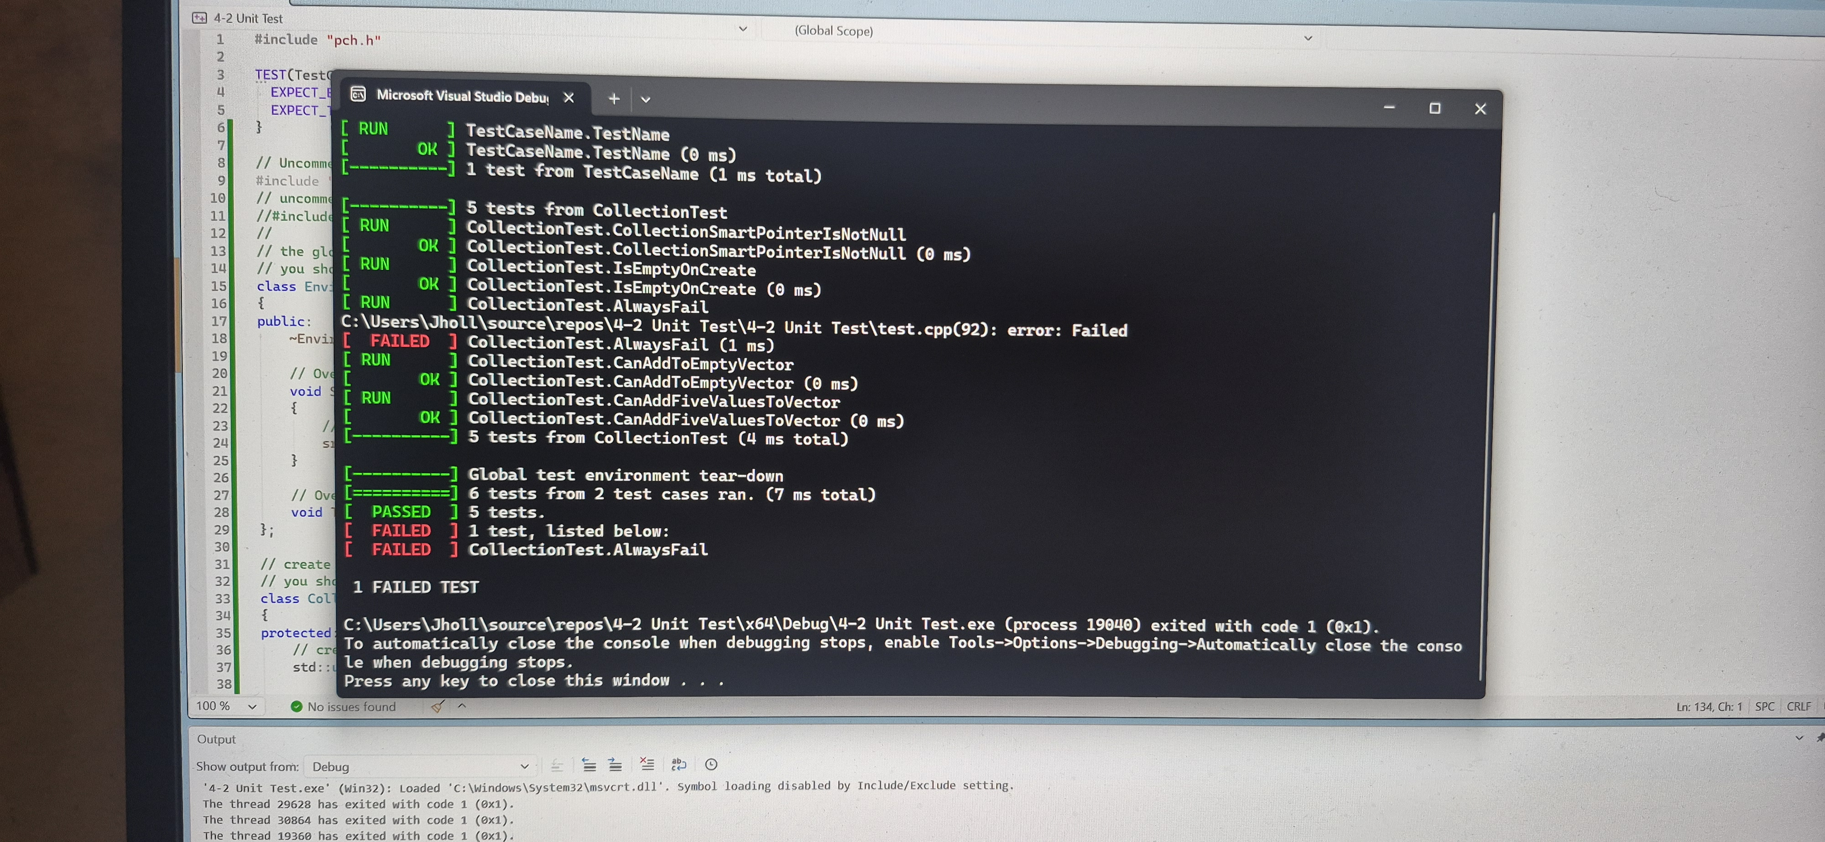
Unit Testing
Unit testing is a practice in software development where parts of an applications that are small and can be tested are isolated and given a test run to confirm they're working correctly. These part are mostly classes, individual functions, or methods.

Slide 9

AUTOMATION SUMMARY

Slide 10
TOOLS
  DevSecOps pipeline is simply put a software delivery flow that will integrate automated security practices, policies, and checks into all the DevSecOps' stages.
  The first tool is threat modeling and collaboration, this is used during the development stage to assess any possible security threats before you start writing code.
  Second tool is Pre-Build and secret scanning, this gets integrated right into the source code manager to analyze files for things like tokens, API keys, or insecure code configurations.
  Third tool is Static Composition Analysis, this gets executed by CI runners. The SAST will check the proprietary code for any structure bugs while the SCA will look for any third party components for license compliance.
  Fourth tool is artifact and container scanning, this gets run on built containers and compiled packages to create an image of Software Bill of Materials and looks for any infrastructure vulnerabilities.
  Fifth tool is the dynamic testing, this interrogates any running tests. It'll stage an active hacking attempt on a live flow for demonstration purposes.
  The sixth and final tool is IaC validation and configuration, this will confirm infrastructure as code scripts to watch for any cloud misconfigurations or any overly privilege identities before deploying starts.

Slide 11
RISKS AND BENEFITS
The Problem: Cyber-attacks are caused remotely and can technically happen at any given moment, as effective as defense in depth and the triple-A principles are? They have on occasions failed, so there's nothing that is truly a hundred percent secured.
The Solution: Use Defense in Depth and Triple-A policies for signing into an application to reduce the chance of an attack.
This tip is beneficial because it has shown by white hat hackers that it is very hard to break into a system when you employ the defense in depth and triple-a policies. This causes headache for black hat hackers and they eventually give up.
If you have data that is super sensitive? Then it's for the best you work on it at your place of residence that way it'll be only you that can physically access it.

Slide 12
RECOMMENDATIONS
    The best way of filling in the gaps when it comes to cyber-attacks is to consistently keep up with the security threats and patterns. This is crucial to delivering the level of security that app users expect. Keep things simple and straight forward, but also take whatever measures necessary to complete the task.

Slide 13
CONCLUSIONS
Bringing this to a close, with all the principles and coding practices that I've laid down in this presentation? I can say that most if not all the major topics of secure coding were addressed to build a well-rounded security policy. I also did address the zero trust when it comes to accessing certain things that are inside and outside of a network, sustaining security of confidential information for everyone who is involved.

Slide 14
REFERENCES
Litvinyuk, S., Pilyugin, P., & Petukhov, A. (2024). Formal Methods For Building Network-Level Information Security Policies. 2024 International Scientific and Technical Conference Modern Computer Network Technologies (MoNeTeC), Scientific and Technical Conference Modern Computer Network Technologies (MoNeTeC), 2024 International, 1–5. https://doi.org/10.1109/MoNeTec60984.2024.10768180
Babanov, V. (2024). Internals of defense-in-depth strategy in cybersecurity. Security & Defense / Sigurnost i Otbrana, 2, 37–42. https://doi.org/10.70265/PNEZ3158
Nguyen, V. H., & Nguyen, K. K. (2026). Triple-Layered Anti-Interception Security Framework for Ground Combat Vehicular Networks. ICC 2026 - IEEE International Conference on Communications, Communications, ICC 2026 - IEEE International Conference On, 1–6. https://doi.org/10.1109/ICC59461.2026.11588185
Ramirez, A., Aiello, A., & Lincke, S. J. (2020). A Survey and Comparison of Secure Software Development Standards. 2020 13th CMI Conference on Cybersecurity and Privacy (CMI) - Digital Transformation - Potentials and Challenges(51275), Cybersecurity and Privacy (CMI) - Digital Transformation - Potentials and Challenges, 2020 13th CMI Conference On, 1–6. https://doi.org/10.1109/CMI51275.2020.9322704

